Slide 1

Digital Electronics (203105201)
Alpita makwana, Assistant Professor
Mechatronics Engineering

Slide 2
CHAPTER-1
Fundamentals of Digital Systems and Logic Families
Digital signals, digital circuits, Number Systems::binary, signed binary,
octal hexadecimal number, binary arithmetic, one’s and two’s complements arithmetic, codes, BCD arithmetic, error detecting and correcting codes,
AND, OR, NOT, NAND, NOR, and Exclusive-OR operations, examples of IC gates, characteristics of digital lCs,
Digital Logic families:: TTL and CMOS logic, interfacing CMOS and TTL

Slide 3
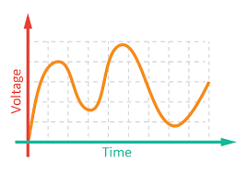
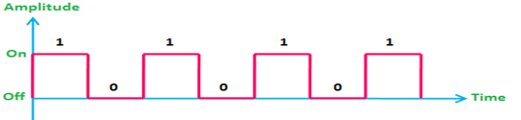
Fundamentals of Digital Systems and Logic Families
Digital Signal
Signal: A physical quantity, which contain some information and which is function of one or more variables.
Type of Signal:
Analog Signals
Digital Signals
Analog Signals: Signal having continuous values and infinite number of different values.
Examples: Things observed in nature are analog like Temperature, Pressure, Distance, Sound and Current.
Digital Signals: Signal which has only a finite number of distinct values.
Examples: Signals obtained directly from computers, Output of A to D converter.
Is there anything between Analog and Digital Signal?
Image source : Google

Slide 4
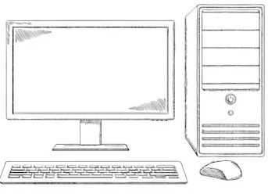


Fundamentals of Digital Systems and Logic Families
Digital Circuits/Systems
Digital circuits have input signal and output signal both are digitals.
Digital Computer Digital Television Traffic Control System
Image source : Google

Slide 5
Fundamentals of Digital Systems and Logic Families
Number Systems
Sets of values used to represent quantity like number of students attending classes, Grades archived by students in tests, etc.
Various Number Systems:
Name of Number system | Base (radix-r) | Number of Digits (r) | Largest value of Digit (r-1) | Weight value (r) | Range (0 to r-1)
Binary | 2 | 2 | 1 | 2 | 0,1
Octal | 8 | 8 | 7 | 8 | 0-7
Decimal | 10 | 10 | 9 | 10 | 0-9
Hexadecimal | 16 | 16 | 15 | 16 | 0-9, A-F

Slide 6
Fundamentals of Digital Systems and Logic Families
Number Systems
Decimal Number System: 12345
Radix, r = 10
Digits : 0,1,2,3,4,5,6,7,8,9 (10 digits)
12345.678 = 1x10⁴ + 2x10³ + 3x10² + 4x10¹ + 5x10⁰ + 6x10⁻¹ + 7x10⁻² + 8x10⁻³
Binary Number System: 10011.11
Radix, r = 2
Digits : 0,1 (2 digits)
10011.11= 1x2⁴ + 0x2³ + 0x2² + 1x2¹ + 1x2⁰ + 1x2⁻¹ + 1x2⁻² = 16+2+1+0.5+0.25 = (19.75)₁₀

Slide 7
Fundamentals of Digital Systems and Logic Families
Number System Conversion
Conversion from any radix to Decimal:
Note down given number.
Write the weight of different positions.
Multiply each digit with corresponding weight to obtain product numbers.
Add all product numbers.

Slide 8
Fundamentals of Digital Systems and Logic Families
Number System Conversion
Conversion from Decimal to other radix:
Separate integer and fractional parts.
For Integer part:
Divide the integer by the base repeatedly until there is nothing to divide.
Keeping track of remainders from each step.
List the remainder values in reverse order to find the equivalent.
For Fractional part:
Multiply the fractional part by the radix(r).
Record the carry generated in this multiplication as MSD.
Multiply only the fractional part of product in step-2.
Repeat step-2 and 3 up to end. Last carry will represent the LSD.
Combine result of Integer part and Fractional part.

Slide 9
Fundamentals of Digital Systems and Logic Families
Number System Conversion
Conversion from Decimal to other radix: (19.75)₁₀ to binary
Separate integer and fractional parts: 19 & 0.75
For Integer part:
Divide the integer by the base (r=2) repeatedly until there is nothing divide
Keeping track of remainders from each step.
List the remainder values in reverse order to find the equivalent.
For Fractional part:
Multiply the fractional part by the radix(r).
Record the carry generated in this multiplication as MSD.
Multiply only the fractional part of product in step-2.
Repeat step-2 and 3 up to end. Last carry will represent the LSD.
Combine result of Integer part and Fractional part.
19=2x9+1 | 1
9=2x4 +1 | 1
4=2x2 +0 | 0
2=2x1 +0 | 0
1=2x0+1 | 1
0.75x2=1.5 | 0.5x2= 1
1 (MSD) | 1 (LSD)
(19.75)₁₀ = (10011.11)₂

Slide 10
Fundamentals of Digital Systems and Logic Families
Number System Conversion
Conversion from Binary to Octal:
Group the binary bits into groups of 3 starting from LSB.
Convert each group into its equivalent octal.
Conversion from Binary to Hex:
Break the binary number in to 4-bit sections from LSB to MSB
Convert each 4-bit binary number into hex equivalent.
Conversion from Octal to Binary:
Convert each octal digit into its equivalent 3-bit binary number.
Conversion from Hex to Binary:
Convert each hex digit to its 4-bit binary equivalent.
Combine the 4-bit sections by removing the spaces.

Slide 11

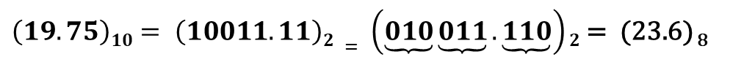
Fundamentals of Digital Systems and Logic Families
Number System Conversion
Conversion from Binary to Octal:
Group the binary bits into groups of 3 starting from LSB.
Convert each group into its equivalent octal.
$\left(19.75\right)10= \left(10011.11\right)2 = \left(\underbrace{010}\underbrace{011}.\underbrace{110}\right)2$ = (23.6) ₈
$$\left(10100.101\right)2=(24.5)8$$

Slide 12

Fundamentals of Digital Systems and Logic Families
Number System Conversion
Conversion from Octal to Hex:
Convert the given octal number into equivalent binary.
Then convert this binary number into hex.
$$\left(15.3\right)8=\left(\text{1101.011}\right)2=\left(\text{D}\text{.6}\right)16$$

Slide 13
Fundamentals of Digital Systems and Logic Families
Number System Conversion
Conversion from hex to Octal:
Represent each hex digit by a 4-bit binary number.
Combine these 4-bit binary sections by removing the spaces.
Now group these binary bits into groups of 3 bits, starting from the LSB side.
Then convert each of this 3 bit group into an octal digit.
$\left(3\text{D}\text{.6}\right)16=\left(\text{00}\text{11} \text{1101.011}\text{0}\right)2$ = $\left(\underbrace{111} \underbrace{101} \text{.} \underbrace{011}\right)2$ = ${\left(\underset{7}{\underbrace{111}} \underset{5}{\underbrace{101}} \underset{.3}{\underbrace{.011}}\right)}_{2}=\left(75.3\right)8$

Slide 14

Fundamentals of Digital Systems and Logic Families
Question [GATE (CS) 2014 SET-2]
Consider the equation (43)_{x}=(y3)₈ , where x and y are unknowns. The number of possible solutions is _____
Sol:
${(43)}_{x}=4×x^{1}+3×x^{0}=4×x+3$,
${(y3)}_{8}=y×8^{1}+3×8^{0}=8×y+3$,
$$⇒4x=8y,$$
$$⇒x=2y,$$
Also, $4<x, and, y<8$
Practice Questions
y | x
0 | 0
1 | 2
2 | 4
3 | 6
4 | 8
5 | 10
6 | 12
7 | 14
8 | 16

Slide 15


Fundamentals of Digital Systems and Logic Families
Question [GATE (CS) 2017 SET-2]
The representation of the value of a 16-bit unsigned integer X in a hexadecimal number system is BCA9. The representation of the value of X in octal number system is:
Sol: ${\left(BCA9\right)}_{16}= {\left(\underset{B}{\underbrace{1011}} \underset{C}{\underbrace{1100}} \underset{A}{\underbrace{1010}} \underset{9}{\underbrace{1001}}\right)}_{2}={\left(\underset{1}{\underbrace{001}} \underset{3}{\underbrace{011}} \underset{6}{\underbrace{110}}\underset{2}{\underbrace{010}} \underset{5}{\underbrace{101}} \underset{1}{\underbrace{001}}\right)}_{2}= {(136251)}_{8}$
Question [GATE (CS) 2023]
A Particular number is written as 132 in radix-4 representation. The same number in radix-5 representation is:
Sol:
$${\left(132\right)}_{4}= {1×4^{2}+3×4^{1}+2×4^{0}=(16+12+2)}_{10}={(30)}_{10}$$
$${(30)}_{10}=a×5^{2}+b×5^{1}+c×5^{0}=25a+5b+c$$
Now, ${(30)}_{10}=25+5+0≡25a+5b+c ⟹a=1, b=1, c=0$
$${{\left(132\right)}_{4}= (30)}_{10}=1×5^{2}+1×5^{1}+0×5^{0}={(110)}_{5}$$

Slide 16
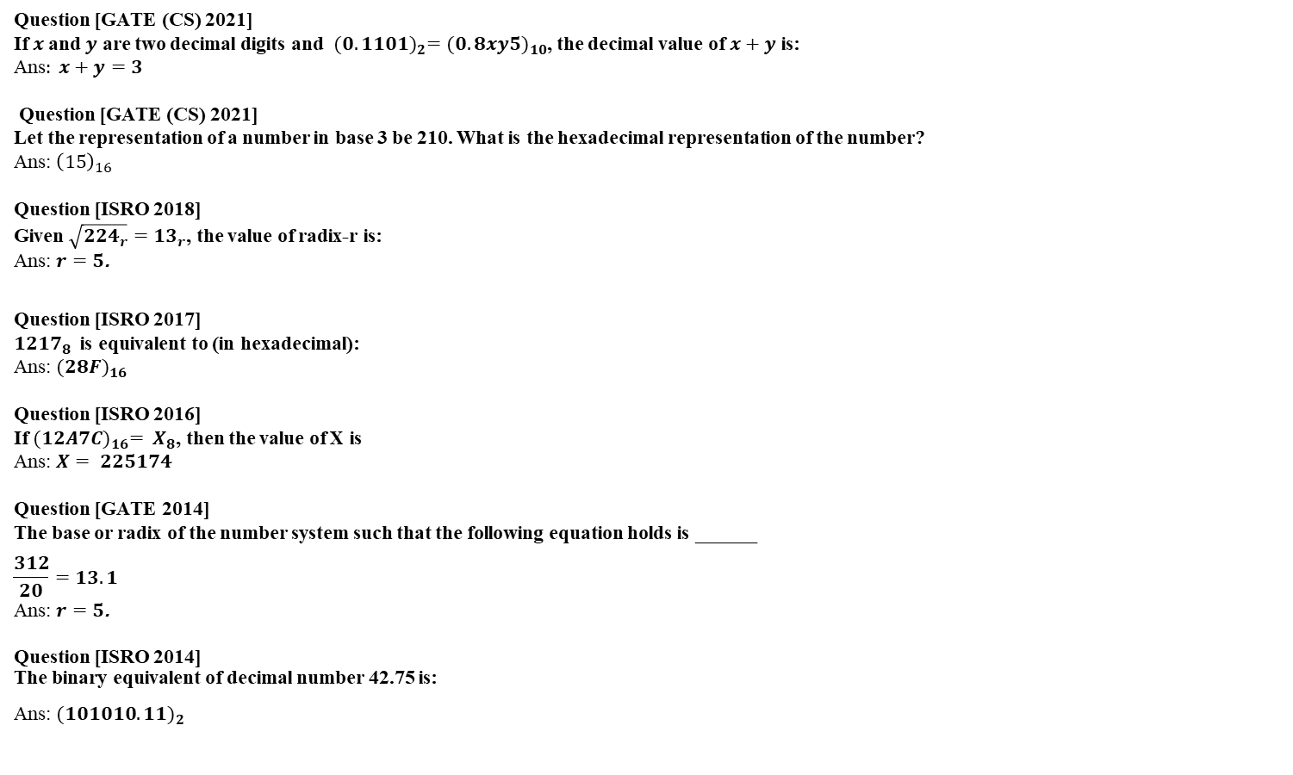
Fundamentals of Digital Systems and Logic Families
Question [GATE (CS) 2021]
If $x$and $y$ are two decimal digits and ${(0.1101)}_{2}={(0.8xy5)}_{10}$, the decimal value of $x+y$ is:
Ans$: x+y=3$
Question [GATE (CS) 2021]
Let the representation of a number in base 3 be 210. What is the hexadecimal representation of the number?
Ans: ${\left(15\right)}_{16}$
Question [ISRO 2018]
Given $\sqrt{{224}_{r}}={13}_{r}$, the value of radix-r is:
Ans: $r=5$.
Question [ISRO 2017]
${1217}_{8}$ is equivalent to (in hexadecimal):
Ans: ${(28F)}_{16}$
Question [ISRO 2016]
If ${(12A7C)}_{16}= X_{8}$, then the value of X is
Ans: $X= 225174$
Question [GATE 2014]
The base or radix of the number system such that the following equation holds is ______
$$\frac{312}{20}=13.1$$
Ans: $r=5$.
Question [ISRO 2014]
The binary equivalent of decimal number 42.75 is:
Ans: ${(101010.11)}_{2}$

Slide 17
Fundamentals of Digital Systems and Logic Families
Binary arithmetic is an essential part of all digital computers and many other digital systems.
Binary arithmetic
Binary Addition: Binary number are added, its creates sum(S) and carry(C).
Binary Subtraction: Its creates Difference(D) and Borrow(B).
A+B | SUM | CARRY
0+0 | 0 | 0
0+1 | 1 | 0
1+0 | 1 | 0
1+1 | 0 | 1
0110 + 0011 = 01001
A-B | DIFFERENCE | BORROW
0-0 | 0 | 0
0-1 | 1 | 1
1-0 | 1 | 0
1-1 | 0 | 0
0110 - 0011 = 00011

Slide 18
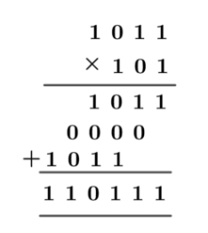
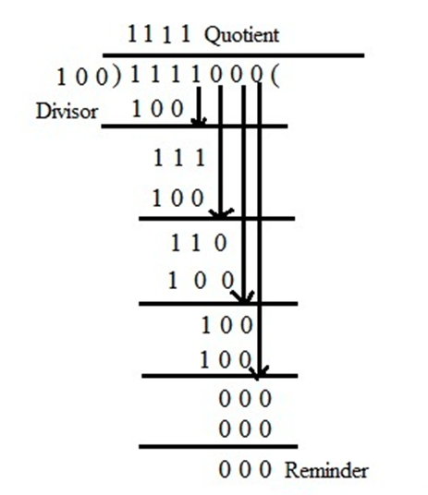
Fundamentals of Digital Systems and Logic Families
Binary Multiplication: It is exactly same as decimal multiplication.
Binary Division: It is exactly same as decimal division. It is called as the long division procedure.
0110 x 0011 = 10010
A | B | Multiply (M)
0 | 0 | 0
0 | 1 | 0
1 | 0 | 0
1 | 1 | 1
0110 ÷ 0011 = 10

Slide 19
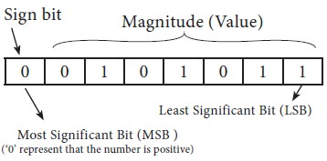

Fundamentals of Digital Systems and Logic Families
Signed binary is very similar to binary, only that it includes negative numbers as well
8-bit sign Binary Number: MSB of binary number is used to represent the sign and the remaining bits are used for magnitude.
Range of n-bit sign binary number:
0 | 0 | 0 | 0 | 0 | 0 | 0
0 | 0 | 0 | 0 | 0 | 0 | 1
. | . | . | . | . | . | .
1 | 1 | 1 | 1 | 1 | 1 | 1
Image source : Google

Slide 20
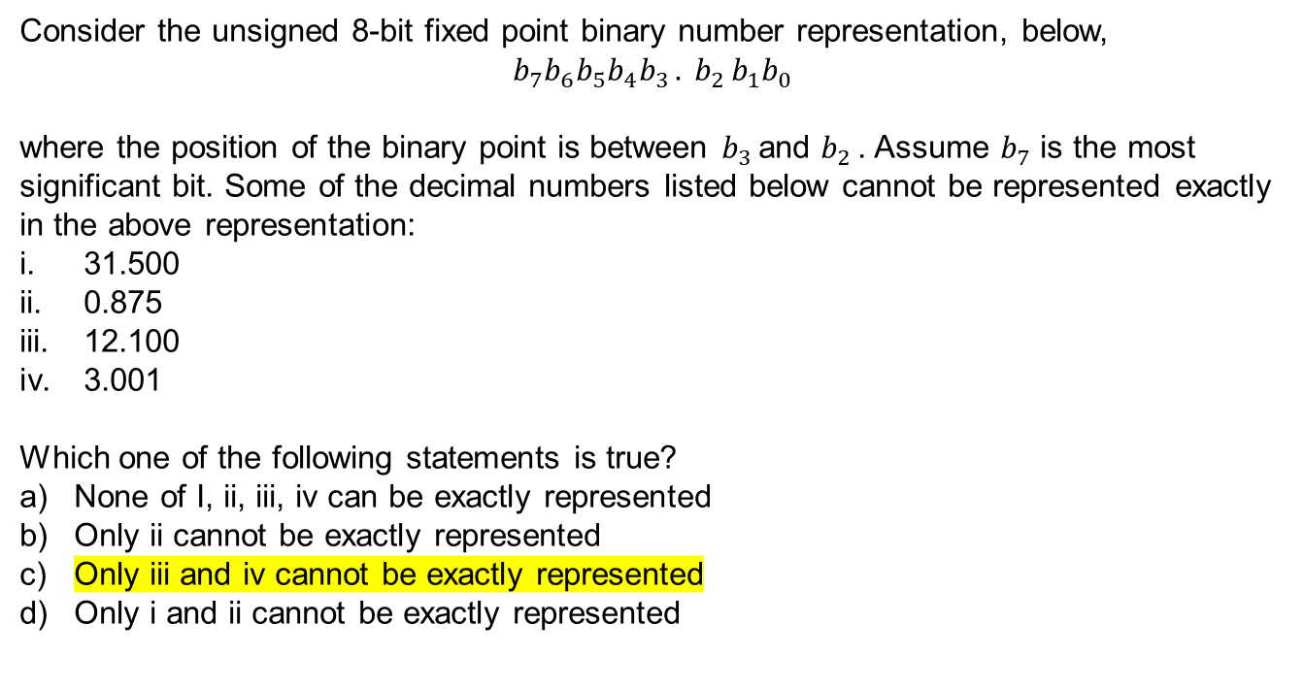
Fundamentals of Digital Systems and Logic Families
Consider the unsigned 8-bit fixed point binary number representation, below,
$$b_{7}b_{6}b_{5}b_{4}b_{3 }{. b}_{2}b_{1}b_{0}$$
where the position of the binary point is between $b_{3 }$and $b_{2 }$. Assume $b_{7}$ is the most significant bit. Some of the decimal numbers listed below cannot be represented exactly in the above representation:
31.500
0.875
12.100
3.001
Which one of the following statements is true?
None of I, ii, iii, iv can be exactly represented
Only ii cannot be exactly represented
Only iii and iv cannot be exactly represented
Only i and ii cannot be exactly represented
Image source : Google

Slide 21
Fundamentals of Digital Systems and Logic Families
Complements are used in digital circuits because it is faster to subtract by adding complements than by performing true subtraction
Type of Complements:
Radix complements (r’s)
Diminished radix complement (r-1)
Diminished radix complement (r-1):
Given a number N in base r having n digits, the (r–1)’s complement of N is defined as: (r^{n} –1) – N
Example:
1’s complement of 1011000 is: (2⁷-1-N)= 1111111–1011000 = 0100111
9’s complement of 546700 is: (10⁶ -1-N)=999999–546700 = 453299
1’s Complement: All ‘0’s become ‘1’s and All ‘1’s become ‘0’s.
Example:
1’s Complement of (10110000)2 is (01001111)2.

Slide 22
Fundamentals of Digital Systems and Logic Families
Complements
Radix Complement (r’s complement):
The r's complement of an n-digit number N in base r is defined as:
( r^{n} – N) for N ≠ 0 and as 0 for N = 0
The r's complement is obtained by adding 1 to the (r - 1) 's complement,
Example:
The 2's complement of 1101100 is 0010100.
The 10's complement of 012398 is 987602.
2’s Complement (Radix Complement):Take 1’s complement then add 1 or Toggle all bits to the left of the first ‘1’ from the right.

Slide 23
Fundamentals of Digital Systems and Logic Families
Complements
Radix Complement (r’s complement):
The r's complement of an n-digit number N in base r is defined as:
( r^{n} – N) for N ≠ 0 and as 0 for N = 0
The r's complement is obtained by adding 1 to the (r - 1) 's complement,
Example:
The 2's complement of 1101100 is 0010100.
The 10's complement of 012398 is 987602.
2’s Complement (Radix Complement):Take 1’s complement then add 1 or Toggle all bits to the left of the first ‘1’ from the right.

Slide 24
Fundamentals of Digital Systems and Logic Families
Subtraction using Complements
The subtraction of two n-digit unsigned numbers, i.e., M – N in base r can be done as follows:

Slide 25
Fundamentals of Digital Systems and Logic Families
Consider two binary numbers:
M=10101 (21) and N=00111 (7)
We take 2's complement of subtrahend 00111, which is 11001.
Now, sum them. So, 10101 + 11001 = 1 01110
In the above result, we get the carry bit 1.
So we discard this carry bit and the remaining is the final result and a positive number.
M=00111 (7) and N=10101 (21)
We take 2's complement of subtrahend 10101, which is 01011.
Now, sum them. So, 00111 + 01011 = 10010
Now, 2’s complement of sum 10010 = 01101+1 = 01110 (14)
1 (-ve sign) 1110 (magnitude, 14)

Slide 26
Fundamentals of Digital Systems and Logic Families
In the coding, when numbers or letters are represented by a specific group of symbols, it is said to be that number or letter is being encoded.
The group of symbols is called as code.
The digital data is represented, stored and transmitted as group of bits. This group of bits is also called as binary code.
Binary codes can be classified into two types.
Weighted codes
Unweighted codes
If the code has positional weights, then it is said to be weighted code. Otherwise, it is an unweighted code.
Weighted codes can be further classified as positively weighted codes and negatively weighted codes.

Slide 27
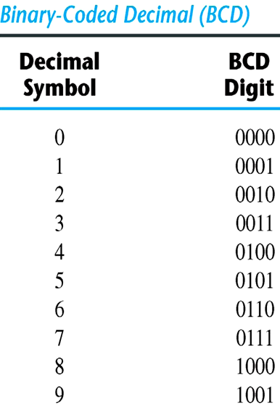
Fundamentals of Digital Systems and Logic Families
Binary codes
BCD code (Binary coded Decimal):
A number with k decimal digits will require 4k bits in BCD.
Decimal 396 is represented in BCD with 12bits as 0011 1001 0110, with each group of 4 bits representing one decimal digit.
A decimal number in BCD is the same as its equivalent binary number only when the number is between 0 and 9.
The binary combinations 1010 through 1111 are not used and have no meaning in BCD.
Image source : Google

Slide 28
Fundamentals of Digital Systems and Logic Families
Decimal Codes:
Image source : Google

Slide 29
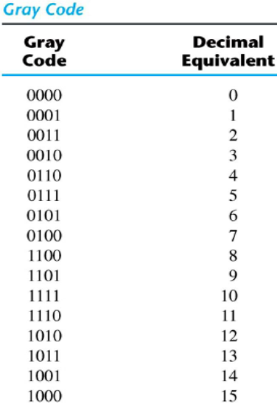
Fundamentals of Digital Systems and Logic Families
Binary codes
Gray Code:
The advantage is that only bit in the code group changes in going from one number to the next.
Image source : Google

Slide 30
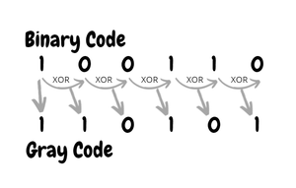
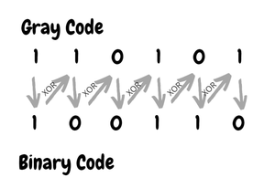
Fundamentals of Digital Systems and Logic Families
Binary to gray conversion:
The Most Significant Bit (MSB) of the gray code is always equal to the MSB of the given binary code.
Other bits of the output gray code can be obtained by XORing binary code bit at that index and the previous index.
Binary codes
Gray to binary conversion :
The Most Significant Bit (MSB) of the binary code is always equal to the MSB of the given gray code.
Other bits of the output binary code can be obtained by checking the gray code bit at that index. If the current gray code bit is 0, then copy the previous binary code bit, else copy the invert of the previous binary code bit.
Image source : Google

Slide 31
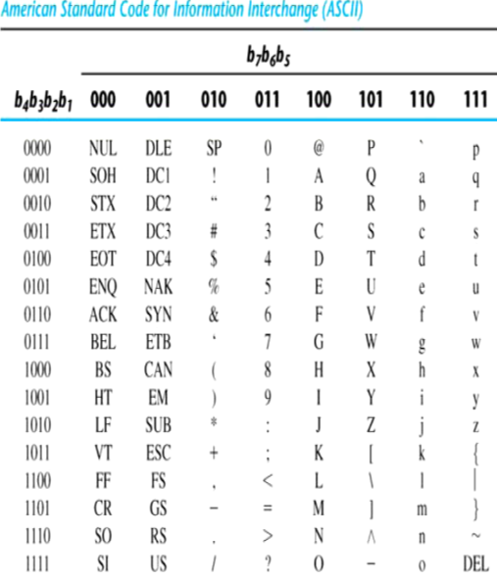
Fundamentals of Digital Systems and Logic Families
Binary codes
American Standard Code for Information Interchange (ASCII) Code:
It uses 7-bits to represent, 94 Graphic printing characters and 34 Non-printing characters.
Some non-printing characters are used for text format (e.g. BS =Backspace, CR = carriage return).
Other non-printing characters are used for record marking and flow control (e.g. STX and ETX).
ASCII has some interesting properties:
Digits 0 to 9 span Hexadecimal values 3016 to 3916.
Upper case A-Z span 4116 to 5A16.
Lower case a-z span 6116 to 7A16.
Image source : Google

Slide 32
Fundamentals of Digital Systems and Logic Families
Error-Detecting Code
To detect errors in data communication and processing, an eighth bit is sometimes added to the ASCII character to indicate its parity.
A parity bit is an extra bit included with a message to make the total number of 1's either even or odd.
Example: Consider the following two characters and their even and odd parity.

Slide 33
Fundamentals of Digital Systems and Logic Families
Error-Correcting Code
Redundancy (e.g. extra information), in the form of extra bits, can be incorporated into binary code words to detect and correct errors.
A simple form of redundancy is parity, an extra bit appended onto the code word to make the number of 1’s odd or even. Parity can detect all single bit errors and some multiple-bit errors.
A code word has even parity if the number of 1’s in the code word is even.
A code word has odd parity if the number of 1’s in the code word is odd.
Example:

Slide 34
Fundamentals of Digital Systems and Logic Families
Hamming Code
Hamming code is a block-code that is capable of detecting up to two simultaneous bit errors and correcting single-bit errors. It was developed by R.W. Hamming for error correction.
In this coding method, the source encodes the message by inserting redundant bits within the message. These redundant bits are extra bits that are generated and inserted at specific positions in the message itself to enable error detection and correction.
When the destination receives this message, it performs recalculations to detect errors and find the bit position that has error.
Encoding a message by Hamming Code
Step 1 − Calculation of the number of redundant bits.
Step 2 − Position the redundant bits.
Step 3 − Calculate the values of each redundant bit.
Once the redundant bits are embedded within the message, this is sent to the user.
Error-Correcting Code

Slide 35
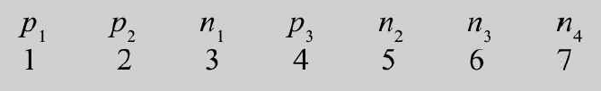

Fundamentals of Digital Systems and Logic Families
Here, k parity bits are added to an n-bit message to form an (n+k) bit code, e.g. 3 parity bits are added to 4 bits of information to make a 7-bit hamming code.
For this, the no. of parity bits, k, must satisfy the inequality: $2^{k}≥n+k+1$
The location of each bit is assigned a decimal number (MSB:1 to LSB: n+k)
k-parity checks are performed on selected bits of the code word.
Result of the parity check is recorded as 1 if there is an error, otherwise it is 0.
The resulting bits are $c_{1} c_{2} c_{3}…..c_{k}$
The decimal value of the binary word formed by $c_{1} c_{2} c_{3}…..c_{k}$ gives the decimal value of the error location.
Example: for 4-bit message, n=4, so, $2^{k}≥5+k$. Therefore k must be atleast 3 (also 3 parity checks)
So, total bits = 4 (message) + 3 (parity) = 7 bits
Error-Correcting Code

Slide 36
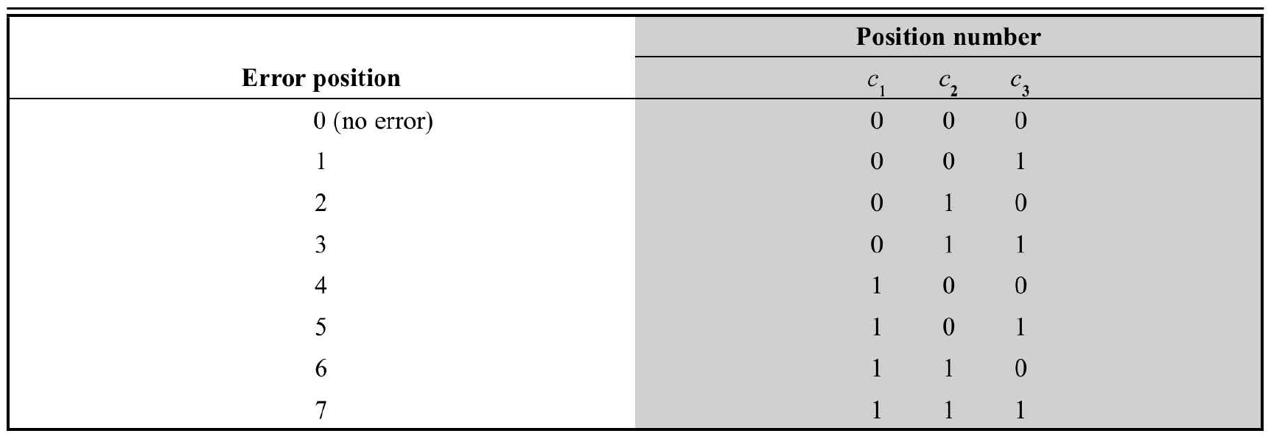
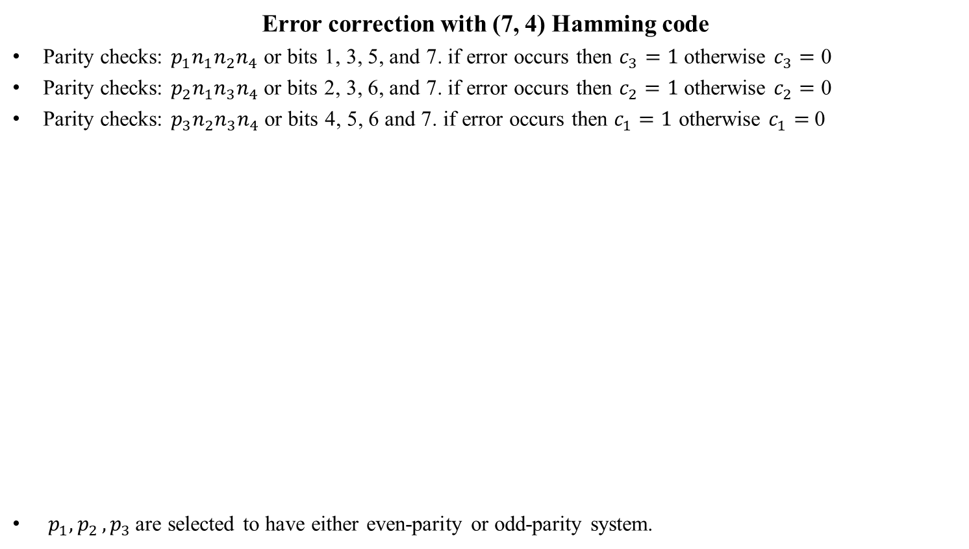
Fundamentals of Digital Systems and Logic Families
Error correction with (7, 4) Hamming code
Parity checks: $p_{1}n_{1}n_{2}n_{4}$ or bits 1, 3, 5, and 7. if error occurs then $c_{3}=1$ otherwise $c_{3}=$ 0
Parity checks: $p_{2}n_{1}n_{3}n_{4}$ or bits 2, 3, 6, and 7. if error occurs then $c_{2}=1$ otherwise $c_{2}=$ 0
Parity checks: $p_{3}n_{2}n_{3}n_{4}$ or bits 4, 5, 6 and 7. if error occurs then $c_{1}=1$ otherwise $c_{1}=$ 0
$p_{1}{, p}_{2}, p_{3 }$are selected to have either even-parity or odd-parity system.
Error-Correcting Code

Slide 37
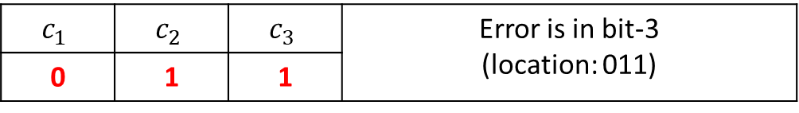
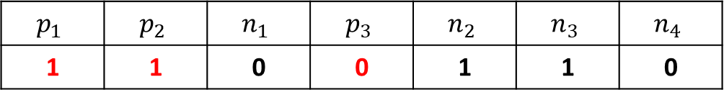

Fundamentals of Digital Systems and Logic Families
Suppose 0110 is to be transmitted (in even parity system)
$p_{1}{, p}_{2}, p_{3 }$are selected to have either even-parity or odd-parity system.
Now suppose 3rd bit gets in error, 1110110
Parity result for 1,3,5,7 : odd. So $c_{3}=1$
Parity result for 2,3,6,7 : odd. So $c_{2}=1$
Parity result for 4,5,6,7 : even. So $c_{1}=0$
Error-Correcting Code
$$p_{1}$$ | $$p_{2}$$ | $$n_{1}$$ | $$p_{3}$$ | $$n_{2}$$ | $$n_{3}$$ | $$n_{4}$$
1 | 1 | 0 | 0 | 1 | 1 | 0
$$c_{1}$$ | $$c_{2}$$ | $$c_{3}$$ | Error is in bit-3 (location: 011)
0 | 1 | 1

Slide 38
Fundamentals of Digital Systems and Logic Families
Binary logic
Binary logic consists of binary variables and a set of logical operations.
The variables are designated by letters of the alphabet, such as A, B, C, x, y, z, etc, with each variable having two and only two distinct possible values: 1 and 0.

Slide 39
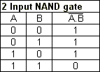
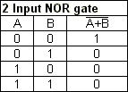
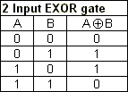
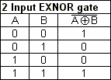




Fundamentals of Digital Systems and Logic Families
Binary logic consists of binary variables and a set of logical operations.
The variables are designated by letters of the alphabet, such as A, B, C, x, y, z, etc, with each variable having two and only two distinct possible values: 1 and 0.
Binary logic
Universal Gates

Slide 40
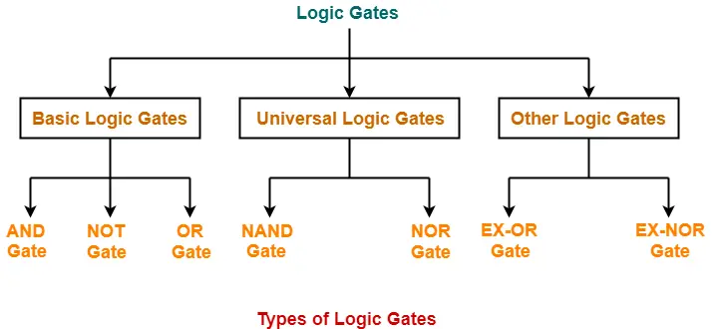
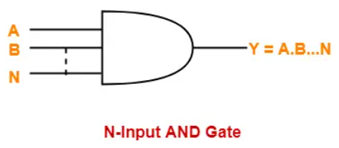
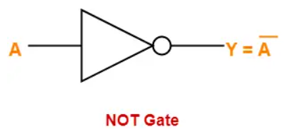
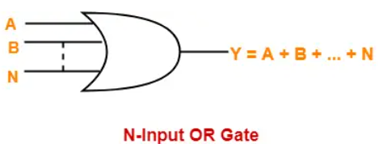
Fundamentals of Digital Systems and Logic Families
Binary logic

Slide 41
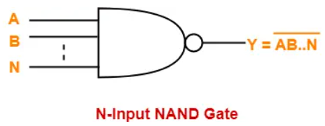
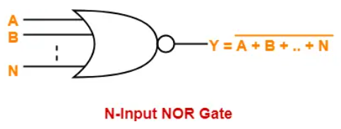
Fundamentals of Digital Systems and Logic Families
Binary logic
A NAND Gate is constructed by connecting a NOT Gate at the output terminal of the AND Gate
- The output of NAND gate is high (‘1’) if at least one of its inputs is low (‘0’)
- The output of NAND gate is low (‘0’) if all of its inputs are high (‘1’)
A NOR Gate is constructed by connecting a NOT Gate at the output terminal of the OR Gate
- The output of OR gate is high (‘1’) if all of its inputs are low (‘0’)
The output of OR gate is low (‘0’) if any of its inputs is high (‘1’)

Slide 42
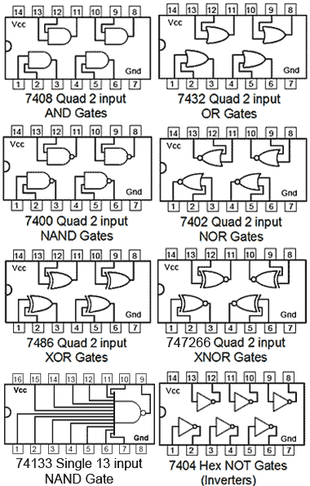
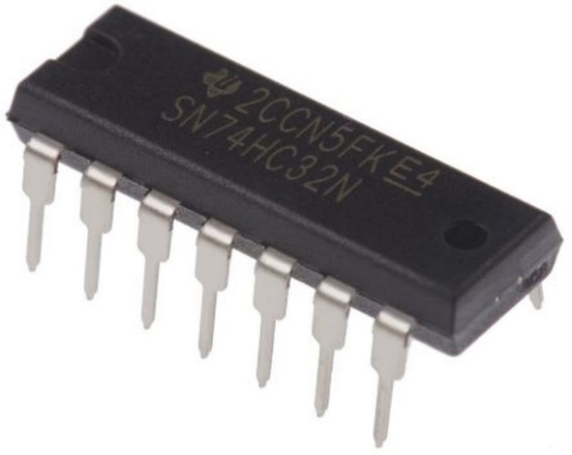
Fundamentals of Digital Systems and Logic Families
Logic Gates IC
Two Input logic gate IC 74xx series:
Image source : Google

Slide 43
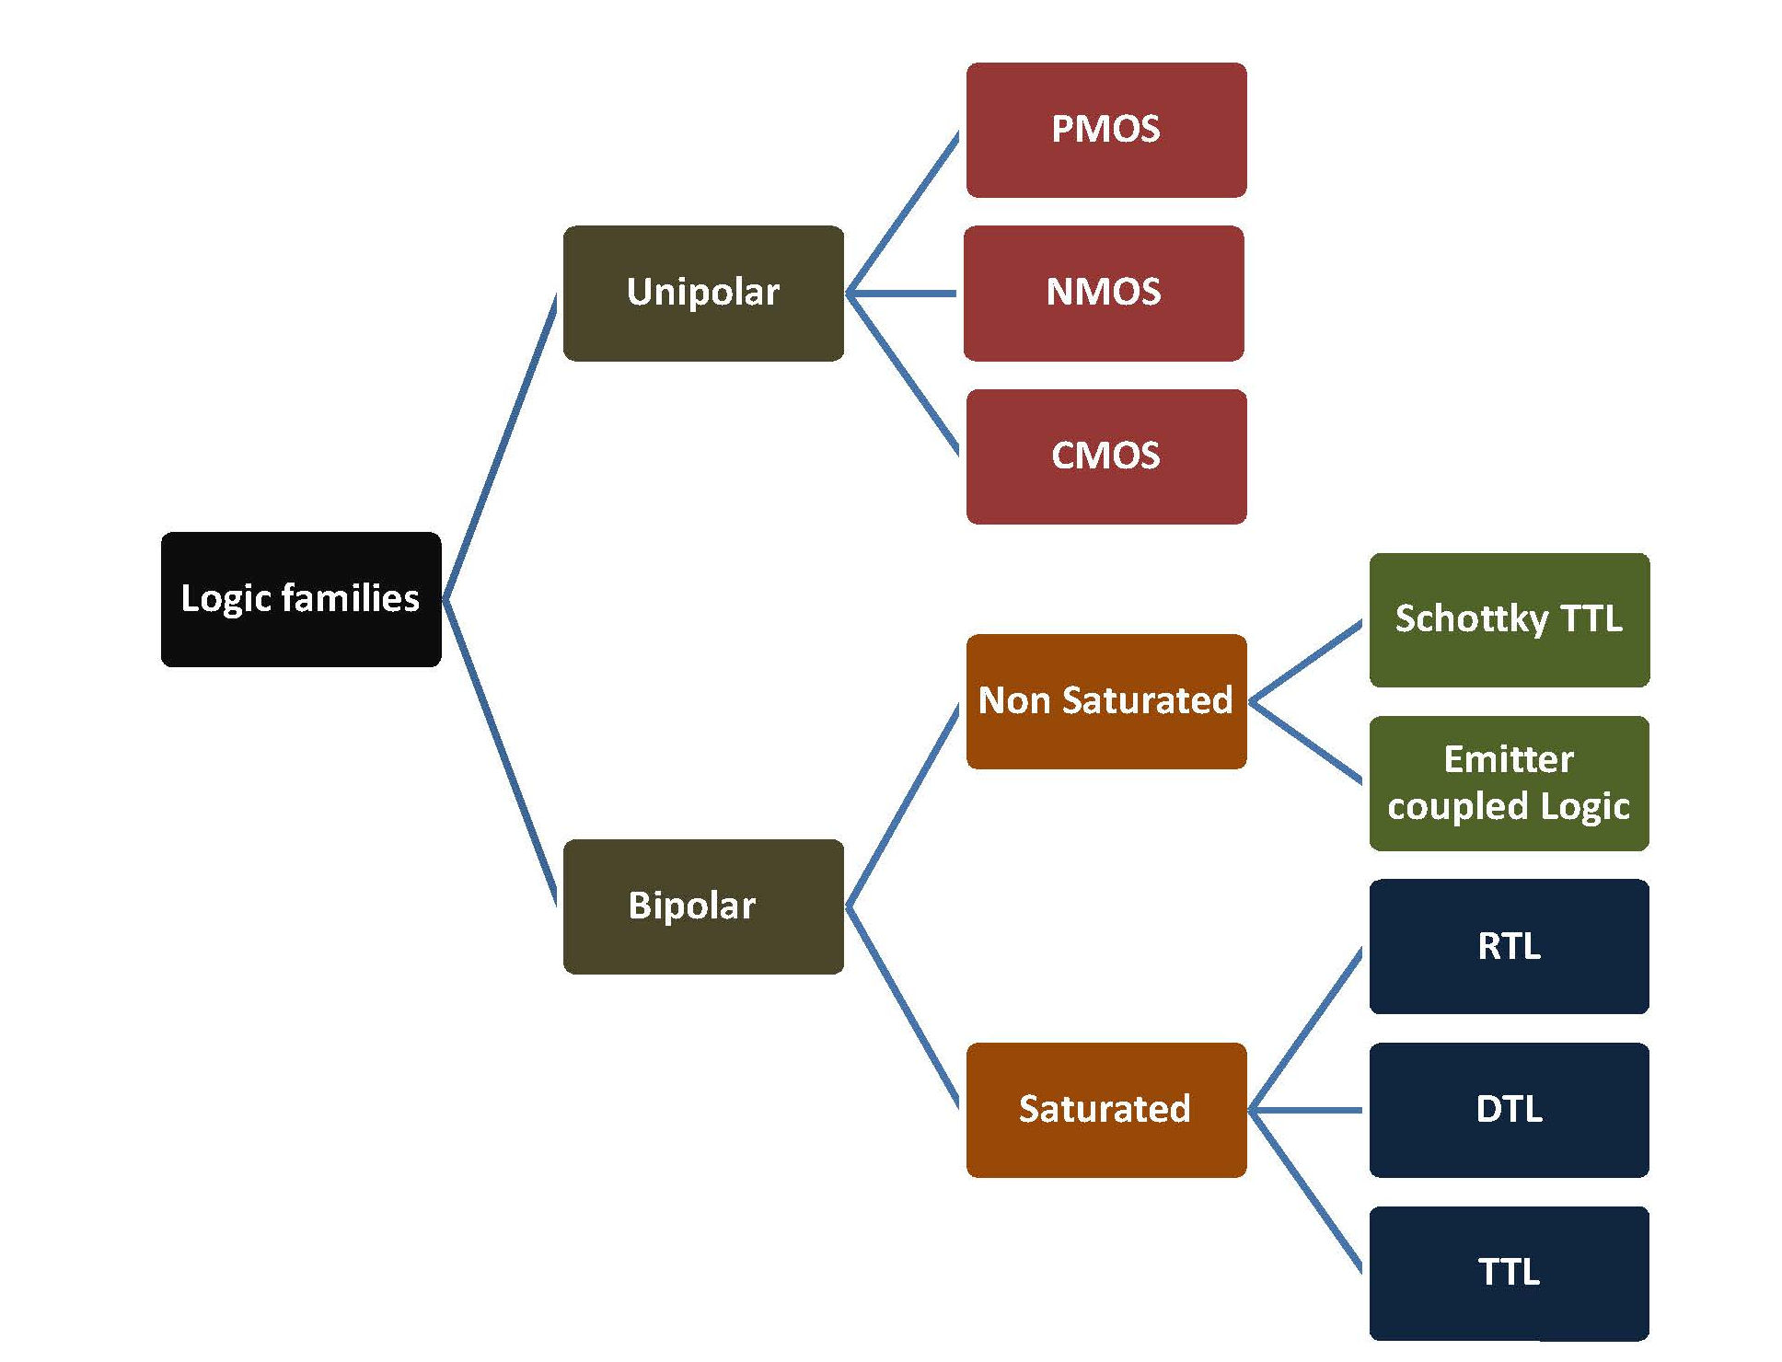
Fundamentals of Digital Systems and Logic Families
The digital integrated circuits are designed using bipolar devices (Bipolar logic families) or Metal Oxide Semiconductor (MOS) (Unipolar family), or a combination of both.
Binary logic
In non-saturated logic, the transistor is switched between the off and active regions.
In saturated logic, the transistor is switched between the off and saturation regions.

Slide 44
Fundamentals of Digital Systems and Logic Families
Common Digital Logic Families:
RTL (Resistor-transistor logic)
DTL (Diode-transistor logic)
TTL (Transistor -transistor logic)
ECL (Emitter-coupled logic)
Digital Logic Families
Saturated
Un-saturated (non-saturated)
Characteristics of Logic Families:
Logic Assignments
Logic voltage levels
Noise margin
Supply voltage
Propagation delay
Fan-in/ Fan-out
Operating speed
Operating temperature
Power Dissipation
Speed-Power Product (Figure of Merit)

Slide 45
Fundamentals of Digital Systems and Logic Families
Logic Assignments
Two possible logic assignments, positive logic or negative logic, are used to implement a Boolean function. For positive logic, a logical "one" is represented by a "high" voltage level, and a logical "zero" is represented by a "low" voltage. The reverse is used to represent negative logic.
Logic Voltage Levels
Logic circuits are normally connected in cascade; that is, the output from one gate is connected to the input of the following gate, and so on. Thus, the switching behavior of one circuit depends not only on its own output characteristic, but may also depend on the input characteristic of the next gate.
Digital Logic Families

Slide 46
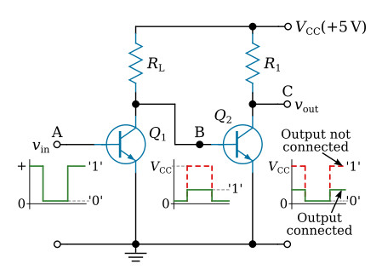
Fundamentals of Digital Systems and Logic Families
Consider the simple case of one inverter circuit driving another as shown in the figure below. With the second transistor disconnected, the output of Q1 will swing from V_{CE (saturated)} (about 0.1 volts), up to V_{CC} (5 V). However, with the second stage connected, the positive voltage at the collector of Q1 will be limited to that of the base-emitter voltage of transistor Q2. Thus, the voltage swing at the output of transistor Q1 will now be from 0.1 to about 0.7 V
Digital Logic Families

Slide 47
Fundamentals of Digital Systems and Logic Families
The output swing of transistor Q1, from 0.1 to 0.7 V, gives satisfactory operating points for the input of Q2, which in turn will give the same swing at its output when it is connected to the input of the next stage.
The conditions for satisfactory switching between the two states are as follows: when Q1 is saturated, its collector voltage must be low enough to keep Q2 cut off; and when Q1 is cut off, the base current of Q2 (dependent on R_{L}) must be high enough to saturate Q2.
For example, standard TTL voltage levels fix the logic 0 level between 0 and +0.8 V, while a logic 1 is between +2.4 and +5 V.
Digital Logic Families

Slide 48
Fundamentals of Digital Systems and Logic Families
Noise Margin
In logic systems, the word noise refers to any unwanted voltage (AC or DC) appearing at the input of a logic circuit. If such a noise voltage were high enough, it could cause the circuit to change state with no change in the input signal voltage.
Both DC and AC noise should be considered in the design of digital systems. The DC noise is the steady drift in the voltage levels of the logic states, and AC noise is the narrow pulses that are created, primarily, by switching transients.
Supply Voltage
Integrated circuit manufacturers include the supply voltage limits of their digital circuits on the data sheets. For example, the correct operation of standard TTL circuits should fall between the 4.75 V and 5.25 V limits of the supply voltage. Within these limits, the device is designed to operate compatibly with the other TTL devices.
Digital Logic Families

Slide 49
Fundamentals of Digital Systems and Logic Families
The DC noise margin (immunity) of a digital circuit is the ability of that circuit to maintain a logic state in the presence of DC noise.
The DC noise margin is expressed by the following equations
Where,
N_{L} - noise immunity of the digital circuit input when the input signal is LOW,
N_{H} - noise immunity of the digital circuit input when the input signal is HIGH,
V_{ILmax} - maximum input voltage that can be read by the circuit as LOW,
V_{OLmax} - maximum output voltage that can represent LOW,
V_{OHmin} - minimum output voltage that can represent HIGH,
V_{IHmin} - minimum input voltage that can be read by the circuit as HIGH.

Slide 50
Fundamentals of Digital Systems and Logic Families
Integrated circuit manufacturers include the voltage level limits of their digital circuits on the data sheets. From those values, the noise immunity can be computed.
For example, a standard TTL logic gate has the following input and output level characteristics:
V_{ILmax} = 0.8 V, V_{OLmax} = 0.4 V
V_{IHmin} = 2 V, V_{OHmin} = 2.4 V
Substituting these values into the noise immunity equations:
and
These values indicate that for reliable operation, the DC noise on the signal lines should not exceed 0.4 V.

Slide 51
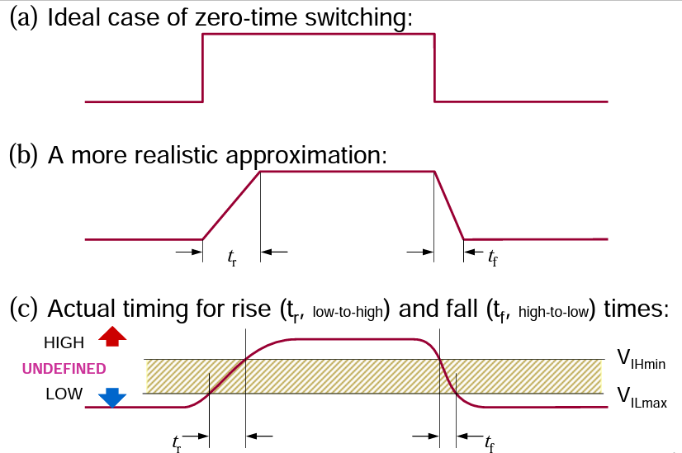
Fundamentals of Digital Systems and Logic Families
Propagation delay:
When the input to a logic gate is changed, the output will not change immediately.
•The switching elements within a gate take a finite time to react to a change (transition) in input.
•As a result, the change in the gate output is delayed w.r.t. to the input change.
•Such delay is called the propagation delay of the logic gate (t_{p})
•The propagation delay for a 0-to-1 output change (t_{pLH}) may be different than the delay for a 1-to-0 change (t_{pHL})

Slide 52
Fundamentals of Digital Systems and Logic Families
Fan-in/Fan-out
Fan-out is the term used to describe the number of loads (inputs) that are driven from a single output. Sometimes it is necessary to better define the maximum fan-out capabilities of a circuit in terms of output current that can be supplied or sunk from a single output.
Fan-in is the number of inputs of a logic gate. Some devices provide increased fan-in by having provisions for the addition of expander circuits; fan-in also can be increased through combinational logic.
Operating Speed
It takes a finite time for a circuit to change from one logic state to the other. In a bipolar transistor, this time is that which is necessary for the base current to supply a charge to, or remove a charge from, the capacitive elements associated with the transistor structure, in order to produce the required voltage change at the output. In a circuit, additional time is required to charge any capacitance associated with the load. This time delay (between input and output) is called the propagation delay of the circuit. Delay values vary considerably depending on the particular circuit, but with integrated logic circuits, the delay is typically in the range of 2 to 50 ns per gate. The overall propagation delay of a complete logic system will be the delay per gate multiplied by the number of gates in series.

Slide 53
Fundamentals of Digital Systems and Logic Families
Operating Temperature
All semiconductor devices are temperature sensitive. This is due primarily to the characteristics of the P-N junctions changing with temperature. Silicon transistors and diodes can operate satisfactorily with junction temperatures up to about 200° C; above this temperature, the characteristics become so poor as to result in inferior performance. Resistors may also change their value with a change of temperature due to the thermal generation of carriers and the change in the mobility of the carriers.
Power Dissipation
The power dissipation of a logic circuit is usually defined as the supply power required for the gate to operate with a 50 percent duty cycle, that is, equal times in the 0 and 1 logic states. The power dissipation of typical integrated logic circuits ranges from a few milliwatts to about 50 mW per gate, depending on the type of circuit. In general, high-speed circuits with short propagation delays require higher power.
Speed-Power Product (Figure of Merit)
The product of power dissipation and propagation delay for a given logic or IC family (should be as low as possible)

Slide 54
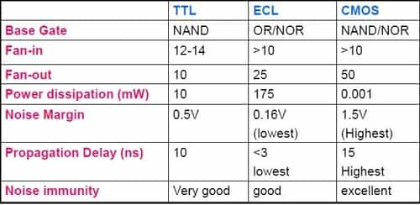
Fundamentals of Digital Systems and Logic Families

Slide 55
Fundamentals of Digital Systems and Logic Families
Type of Digital Logic Families
RTL-NOR
DTL-NAND
Image source : Google

Slide 56
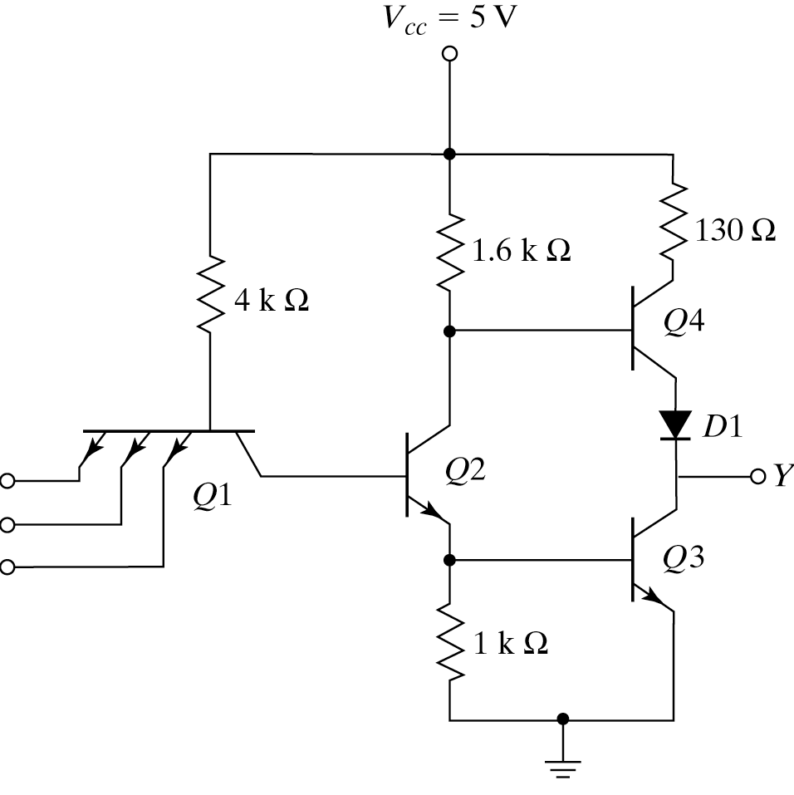
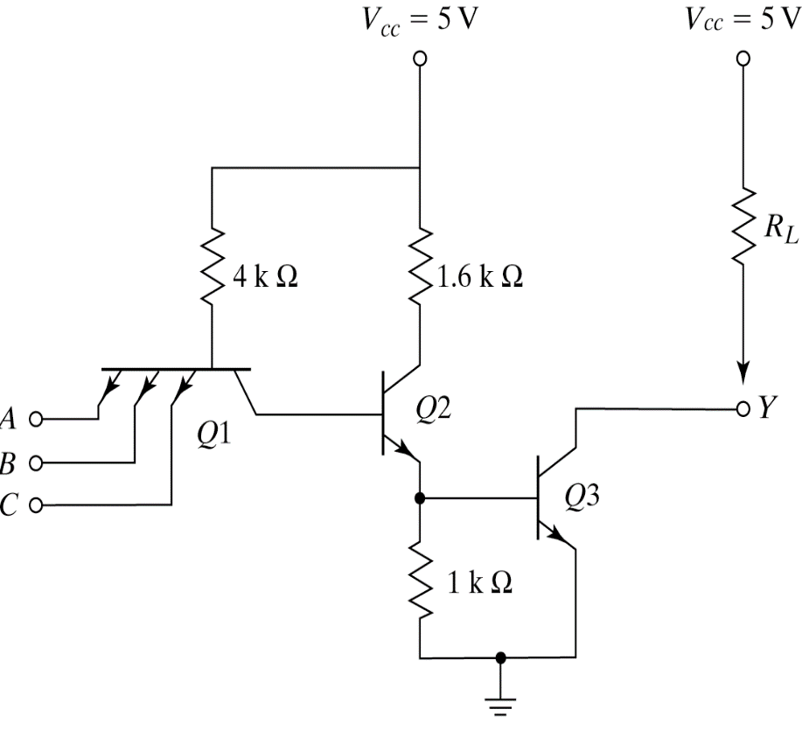
Fundamentals of Digital Systems and Logic Families
TTL NAND Gate With Totem-pole Output Open collector TTL NAND Gate
Type of Digital Logic Families
Transistor-Transistor Logic (TTL):
Image source : Google

Slide 57
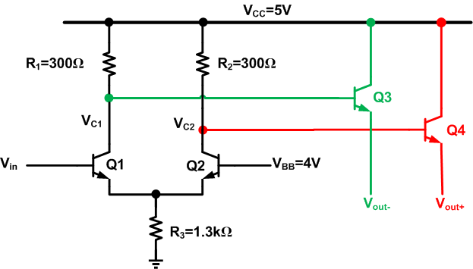
Fundamentals of Digital Systems and Logic Families
Type of Digital Logic Families
EMITTER-COUPLED LOGIC (ECL):
Image source : Google

Slide 58
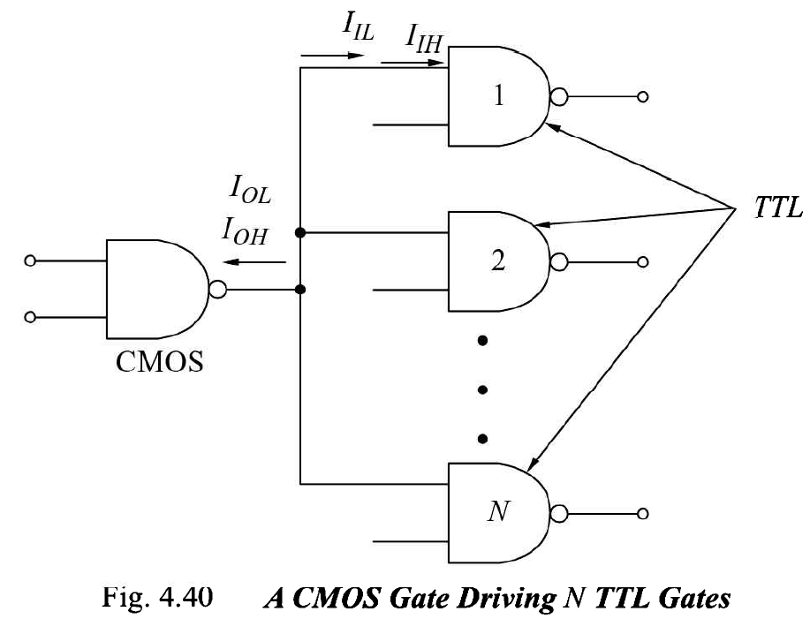
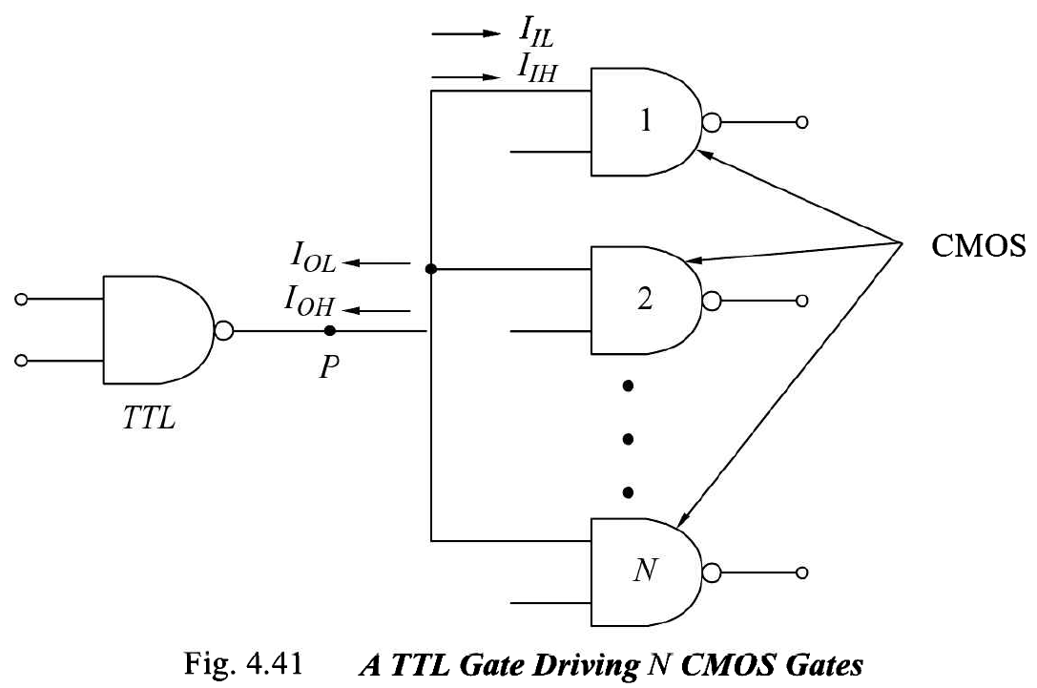
Fundamentals of Digital Systems and Logic Families
CMOS consumes very little power, has excellent noise immunity, and is used with a wide range of voltages.
TTL can drive more current and uses more power than CMOS
Image sources: R P Jain, Modern Digital Electronics, pg. 149-150.

